Slide 1
Vendor Invoice Management VIM / SIM
Vengalrao P
12/8/2017

Slide 2
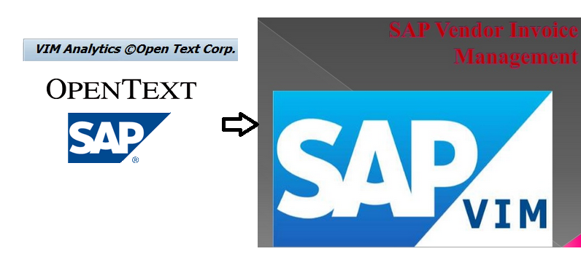
VIM -> SIM

Slide 3
What is SAP Invoice Management or VIM ?
VIM/SIM which is SAP invoice management tool user for handling of incoming invoices to avoid manual process. Manual entry, time-consuming research, comprehensive communication with the supplier, requests for additional communication from multiple parties, manual routing and follow-up on unpaid invoices can all together be replaced by SIM. It eradicates all manual process in handling the invoice.
It is a WORKFLOW tool used to route invoices to approver.
Non PO Invoice indexing → (header) → coding(line item level) (for GL account and cost center) → and approval. (work flow for FB60)
PO invoice routing/approval ONLY in the event of 3 way match failures (work flow for MIRO)
Once approver approves the document, the system will “post” the document into system, ready for payment based on vendor master payment terms

Slide 4
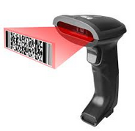
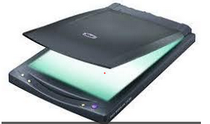
SIM has two scenarios:
1.Non- OCR : Non Optical Character Recognition
This is when basic details are captured from the invoice and a DP (document processing) document will be created manually .
2. OCR : Optical Character Recognition
In this scenario where the invoice is scanned and the details are picked up from the invoice.

Slide 5
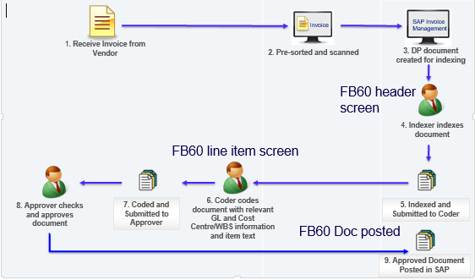
SIM Process Flow for Non-Po type:-

Slide 6
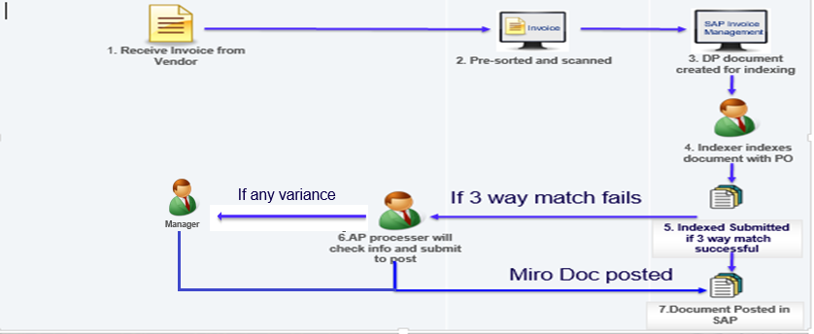
SIM Process Flow for Po type:-

Slide 7
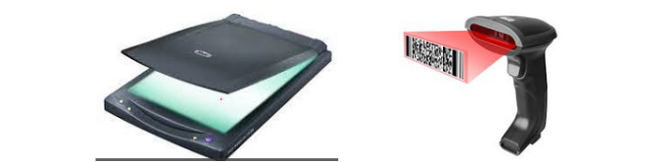
Non Po Process :-
Step 1: Role of Scanner
All the invoices have to be scanned so that the basic data is extracted from the invoice.
Step 2: DP document and workflow
DP document is the scanned invoice. Any invoice that is scanned becomes a DP document. Once the DP document is generated the workflow begins.

Slide 8
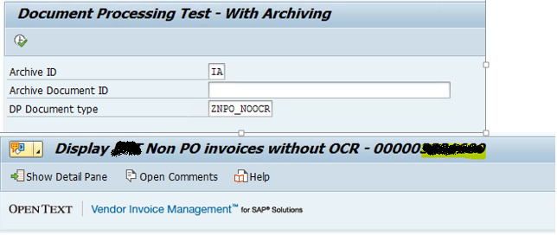
Non Po Process :-
Step 3: Indexer
The indexer maintains the header details of the DP document. This has to be submitted to Coder. He also approves it. Rules are maintained for the Indexer so that he receives the mail in his inbox once the scanning is done. All the indexers will receive a mail and when picked up by one then it will not be accessible to the other indexers. Indexer information will be enabled where his information and the coder mail id will be entered so that the process proceeds with the coder
T-Code:- /OPT/VIM_7AX1

Slide 9
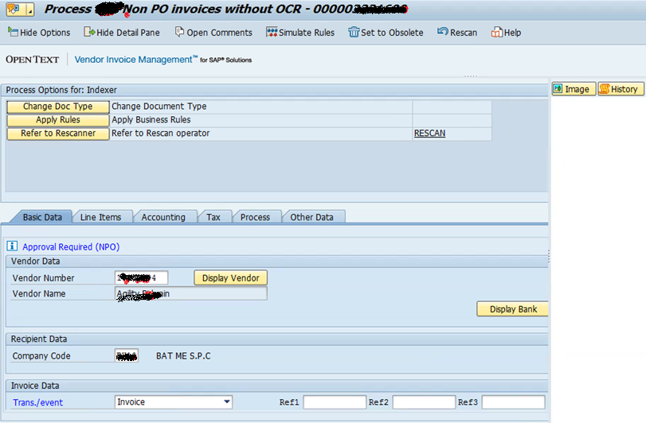
Conti..

Slide 10
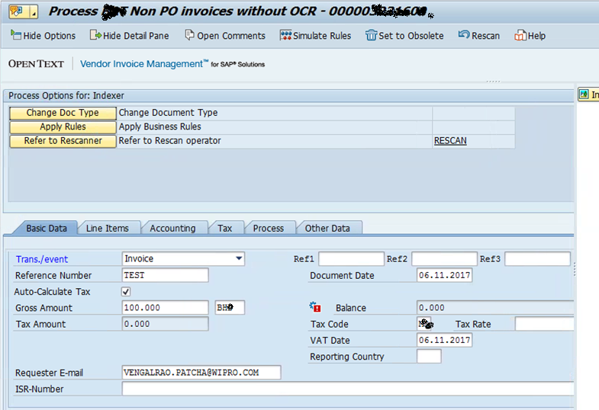
Conti…

Slide 11
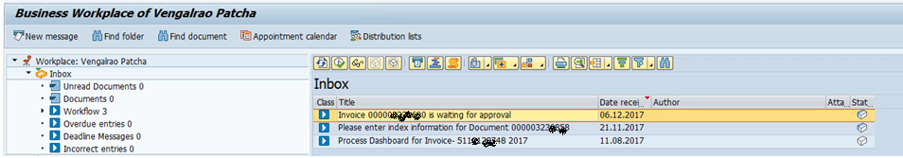
Non Po Process:-
Step 4: Coder
Coder enters the line items of the DP document. Coder has to be maintained. He will save and submit the header and the line item data so that the DP doc moves to the Cost center approver.

Slide 12
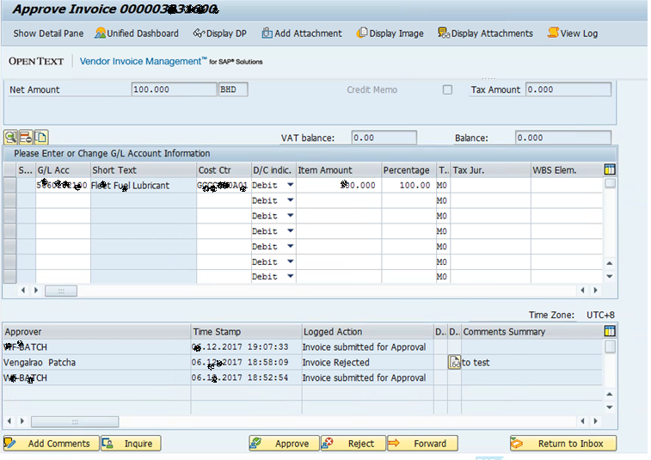
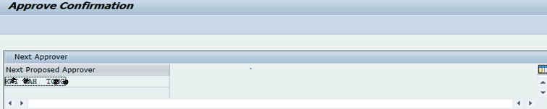
Conti…

Slide 13
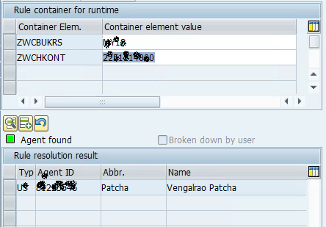
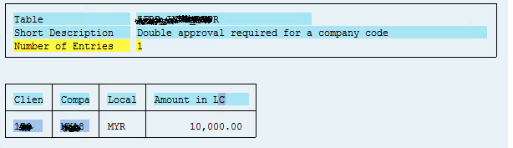
Level of Approvers
Approver is determined based on Cost center owner or GL account owner (if its balance sheet GL only)
DP Approval depends on the amount we coded ( i.e. suppose 1- st level – 10,000 MYR), if the DP document value is more than 10,000 MYR, system will look for 2nd level approval to process DP document.

Slide 14

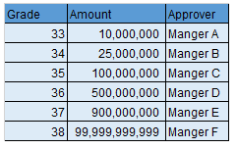
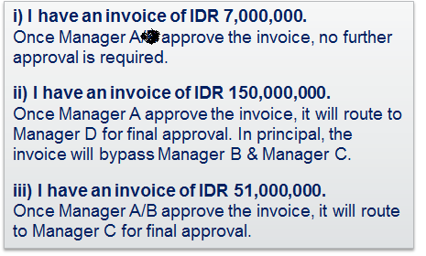
Non Po Process:-
Step 5: Approver
The header and the line items are submitted to the cost center approver for the approval. This approver will be the person responsible in the particular Cost object that is assigned to the GL in the DP document.
All Non PO Invoices must be approved by at least one approver, with any invoices over an agreed threshold requiring two levels of approval.

Slide 15
SIM Process Flow for Po type:-

Slide 16
PO Process :-
Step 1: Role of Scanner
All the invoices have to be scanned so that the basic data is extracted from the invoice.
Step 2: DP document and workflow
DP document is the scanned invoice. Any invoice that is scanned becomes a DP document. Once the DP document is generated the workflow begins.

Slide 17
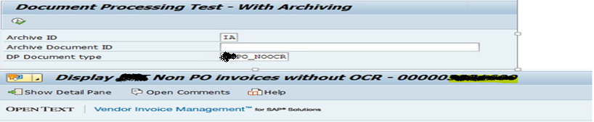
PO Process :-
Step 3: Indexer
Here indexer maintains both header & line item details of the DP document and also give the PO number if all the details match it will post directly .
T-Code:- /OPT/VIM_7AX1

Slide 18
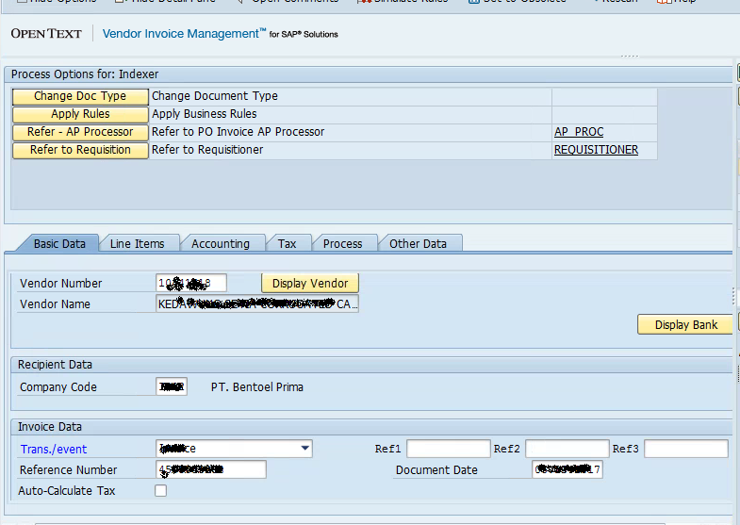
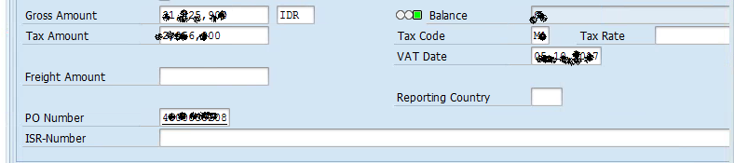
PO process:-

Slide 19
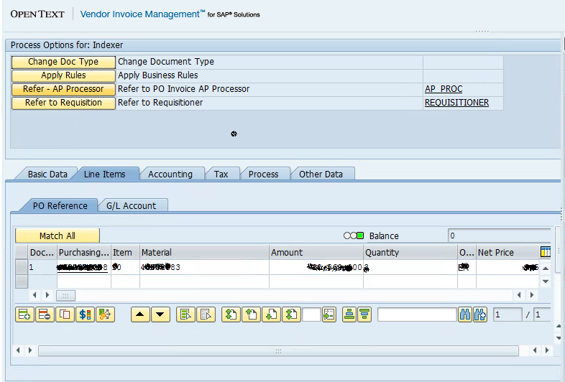
Conti…
PO invoice routing/approval ONLY in the event of 3 way match failures or else its post

Slide 20
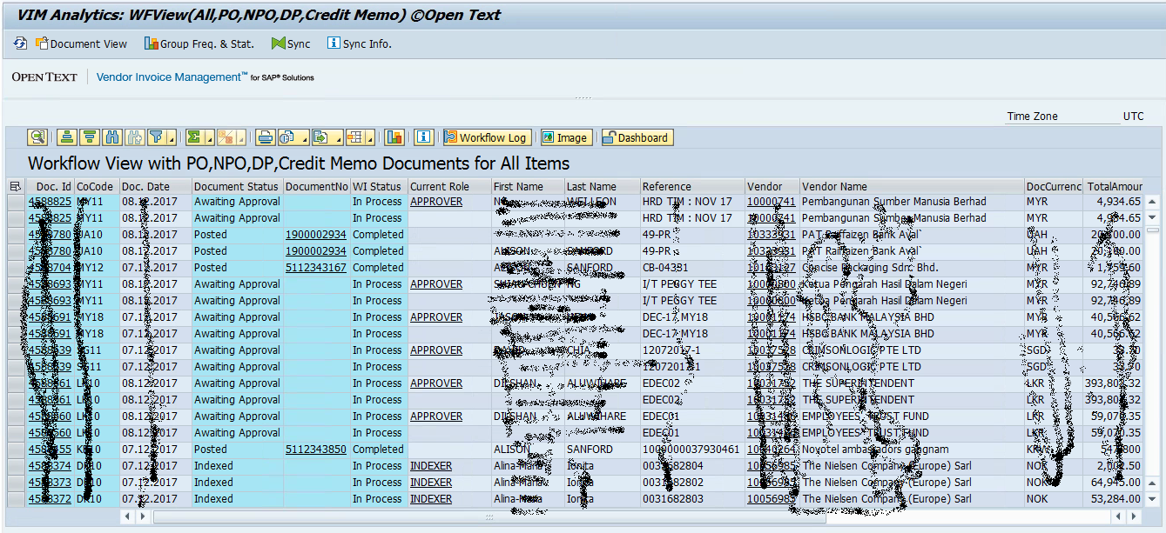
VIM Analytics over view :

Slide 21
Thank you
Q&A

